Slide 1
Using WordPress to Contextualize and Publish Digital Repository Content
Sarah Sweeney
Digital Repository Manager
Northeastern University Libraries, Digital Scholarship Group
Boston, Massachusetts

Slide 2
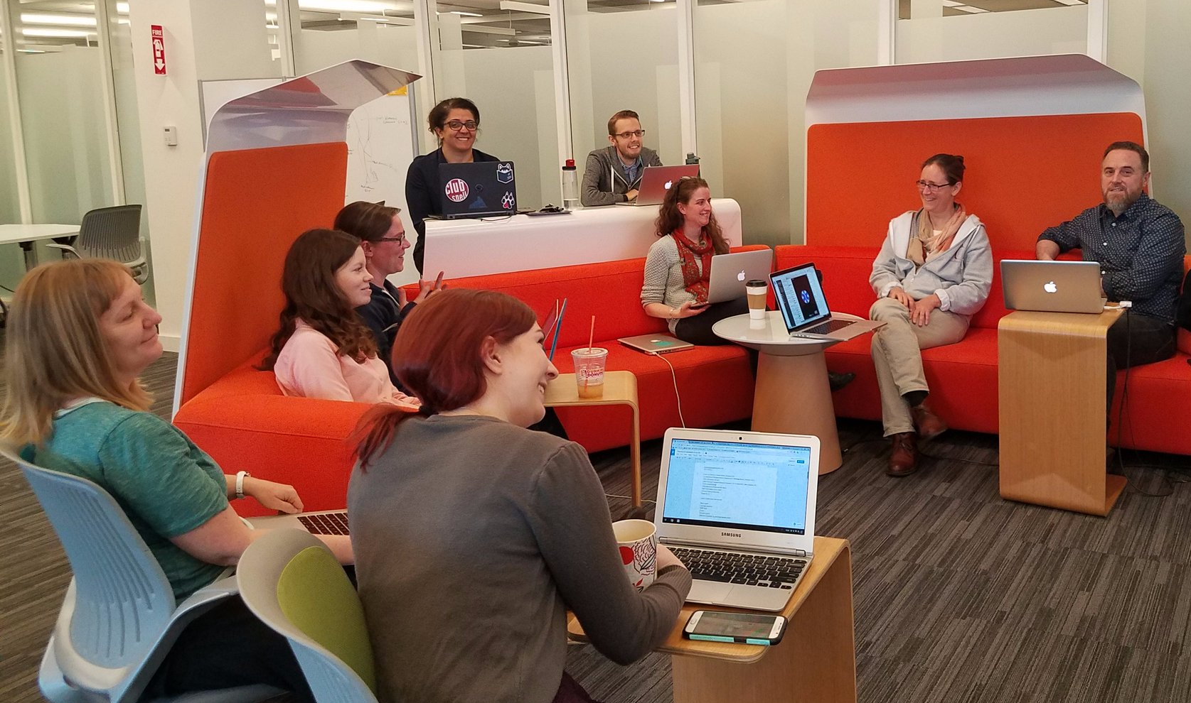
Who We Are
Northeastern University Libraries, Digital Scholarship Group
Text analysis and encoding
GIS
Data visualization
Data management
Repository services
Copyright guidance
Semantic web services

Slide 3
Problem Space
How can we represent the longevity and sustainability of digital humanities (DH) research projects as a shared responsibility?
How can we create a culture of partnership, in which the challenges are understood as shared research challenges?
Notes:
How can we represent the longevity and sustainability of digital humanities research projects as a shared responsibility that begins with fundamental project design decisions and data creation strategies, rather than purely an obligation of the library?
And how can we create a culture of partnership among faculty and student researchers and library staff, in which the challenges of digital curation are understood as shared research challenges rather than functional details of purely “technical” implementation?

Slide 4
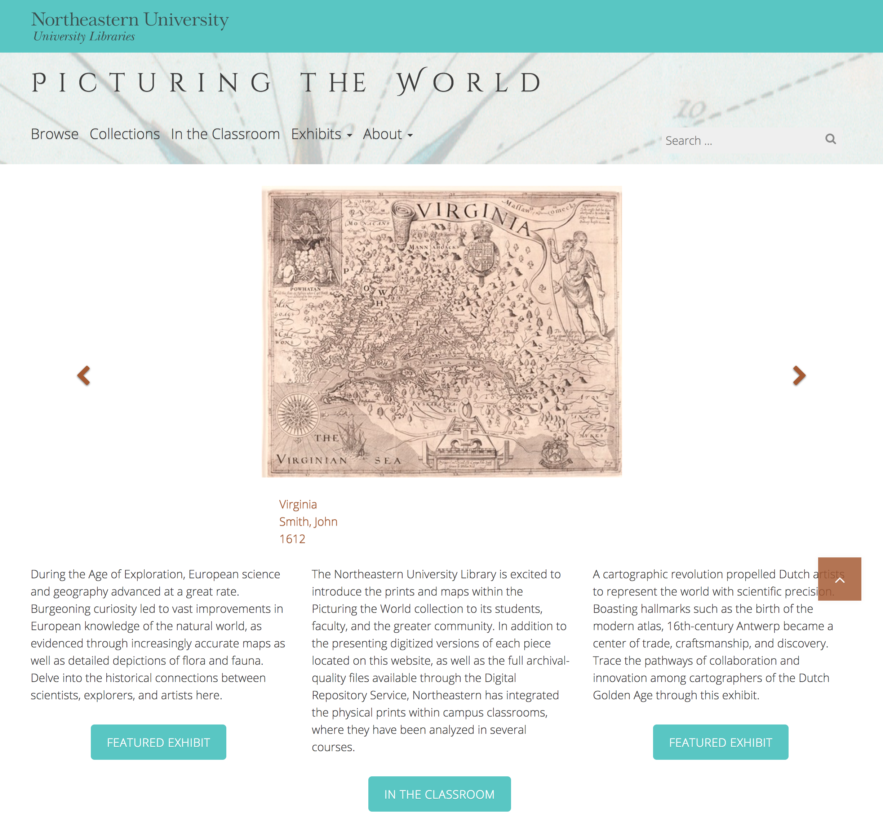
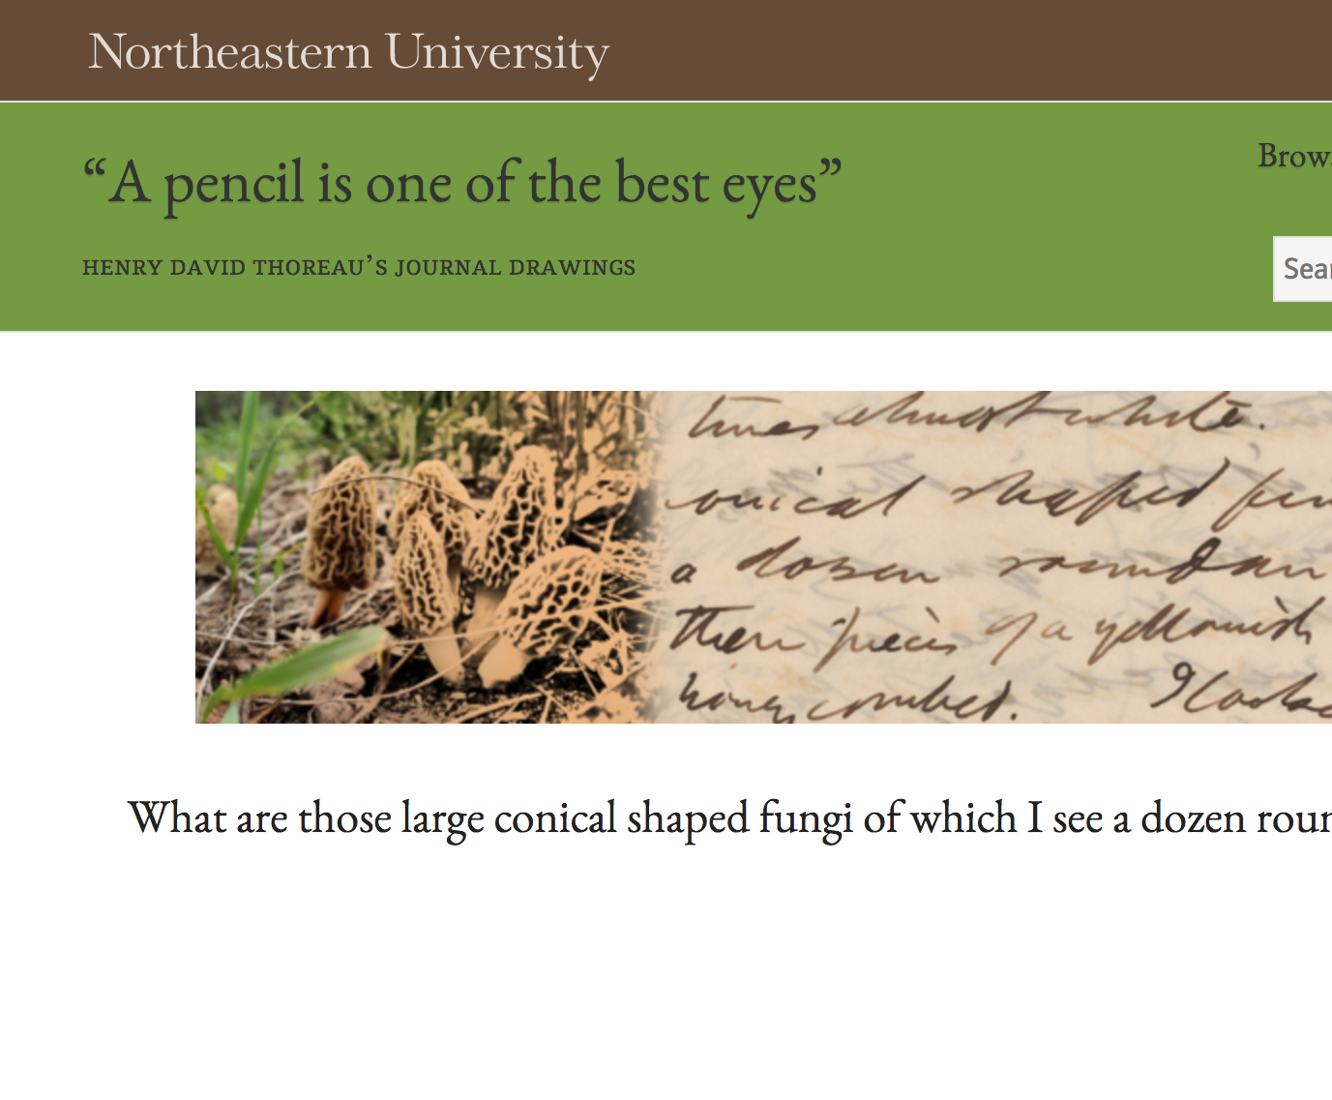
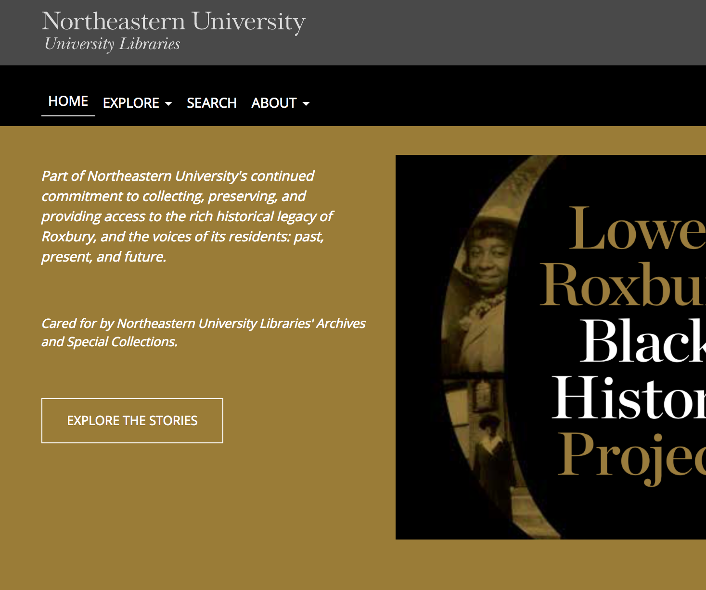
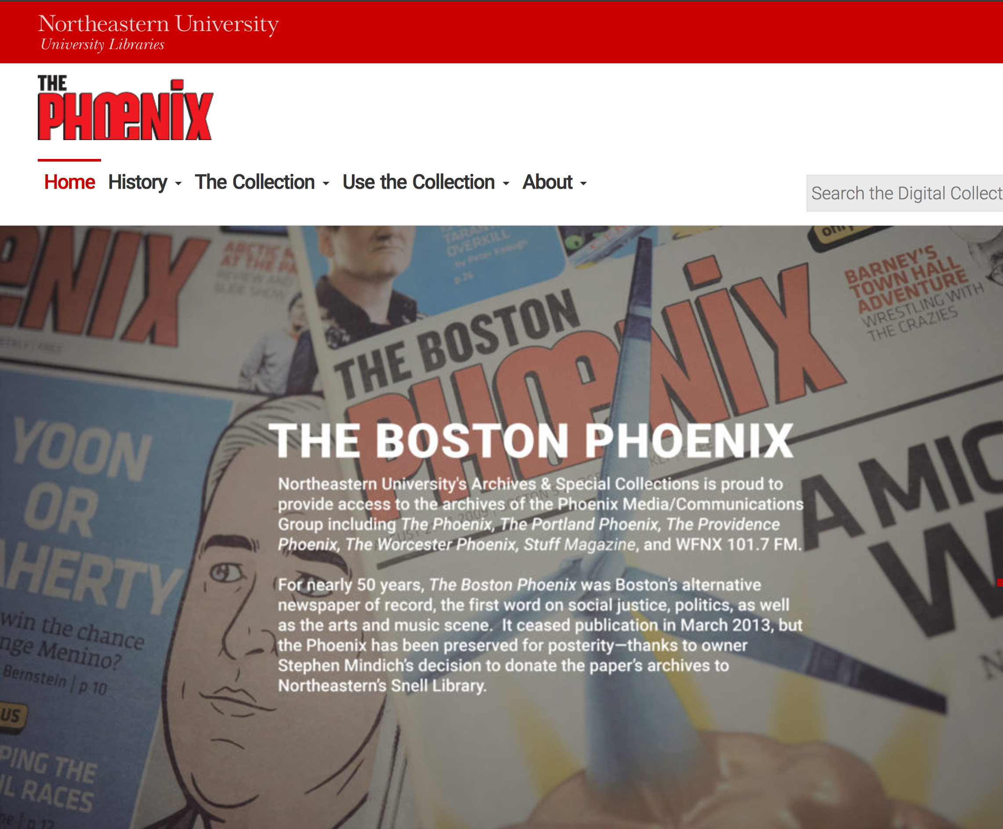
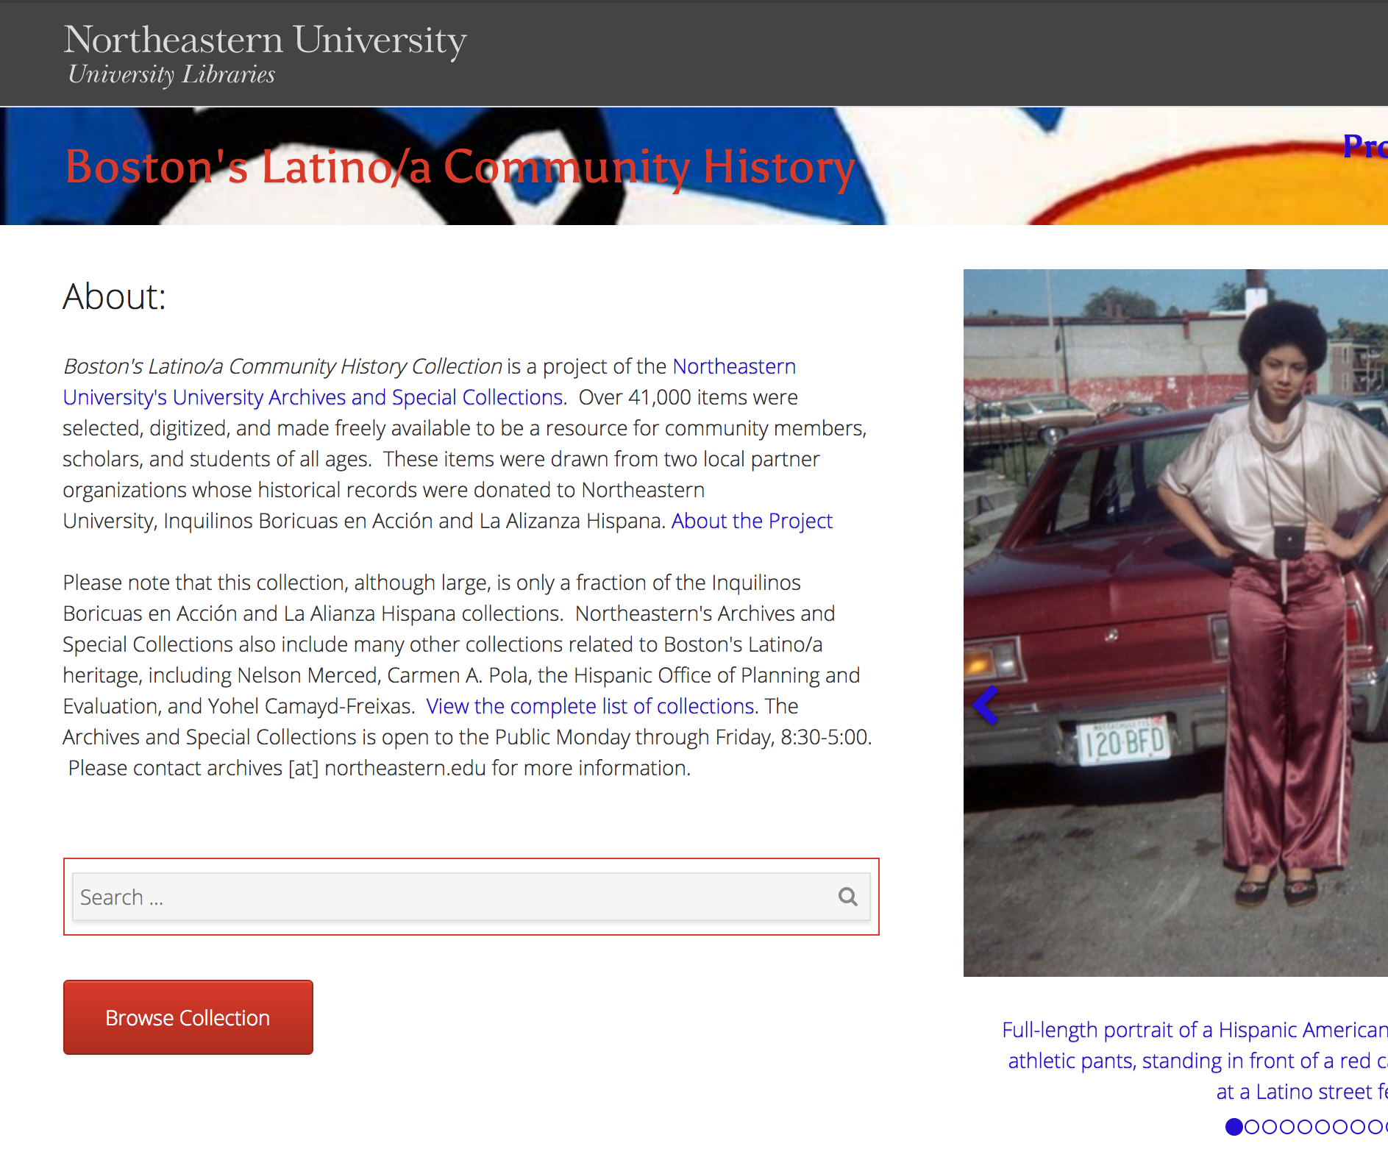
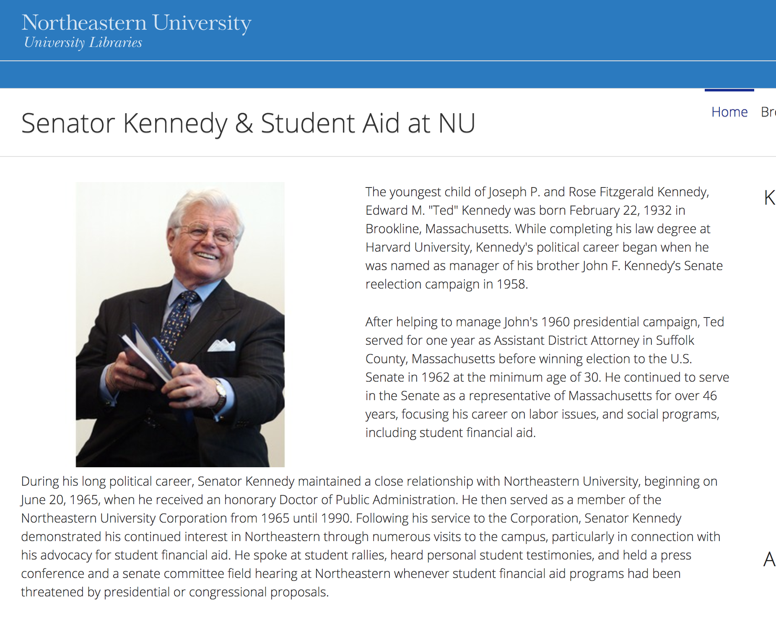
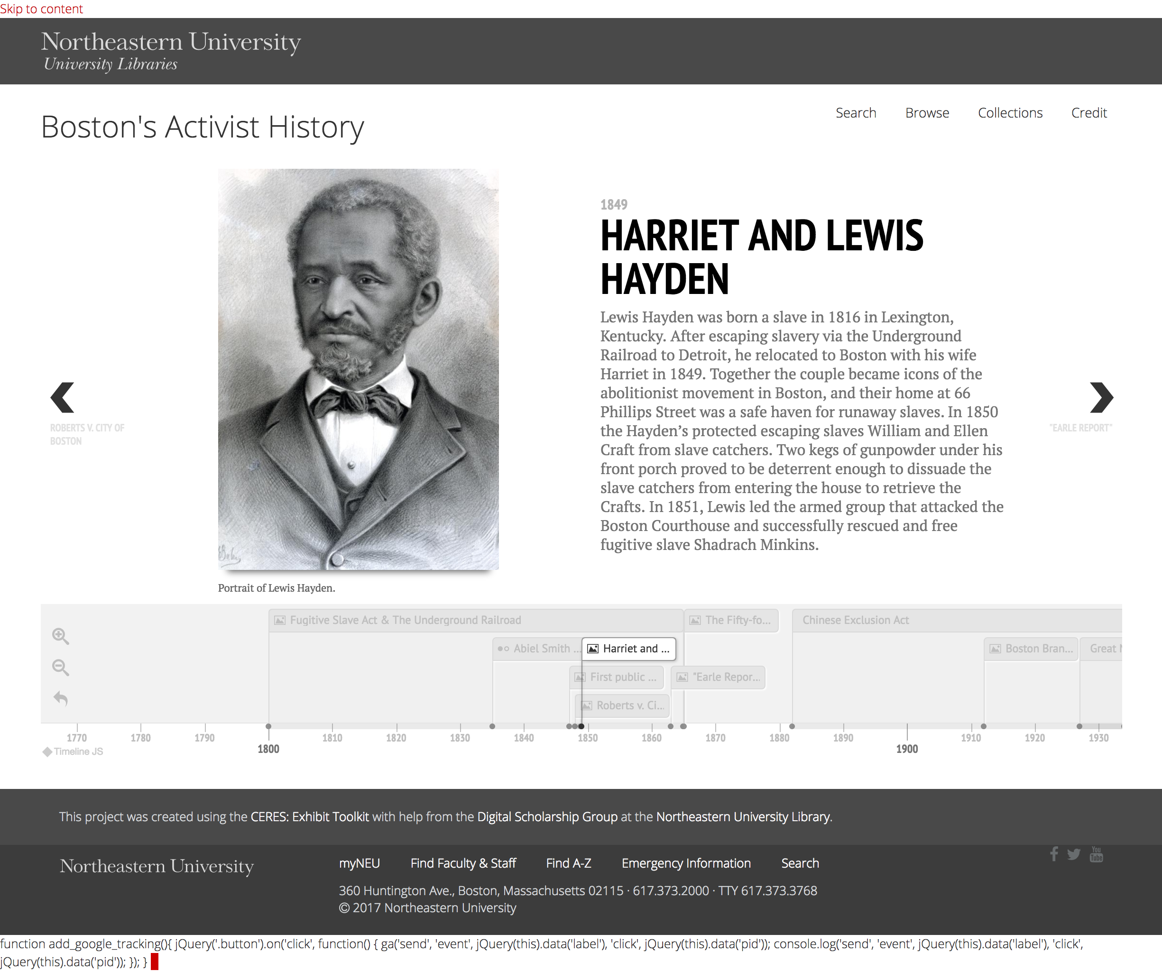
Our Solution
The Community Enhanced Repository for Engaged Scholarship: CERES

Slide 5
Collaborative Development Principles
Support systems, not individual projects.
Materials should be curatable and usable.
Development is a shared research undertaking.

Slide 6
Design
Project Site
Project Site
Project Site
CERES WordPress Plugin
Data Source
Data Source

Slide 7

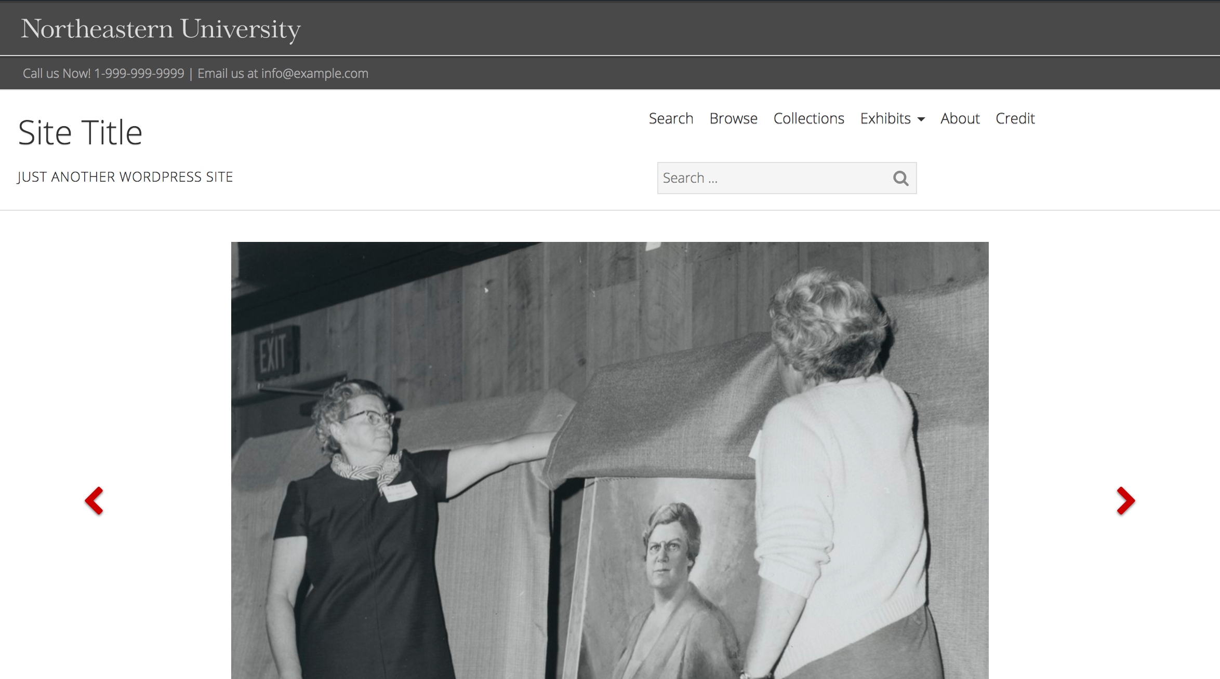
Framework

Slide 8
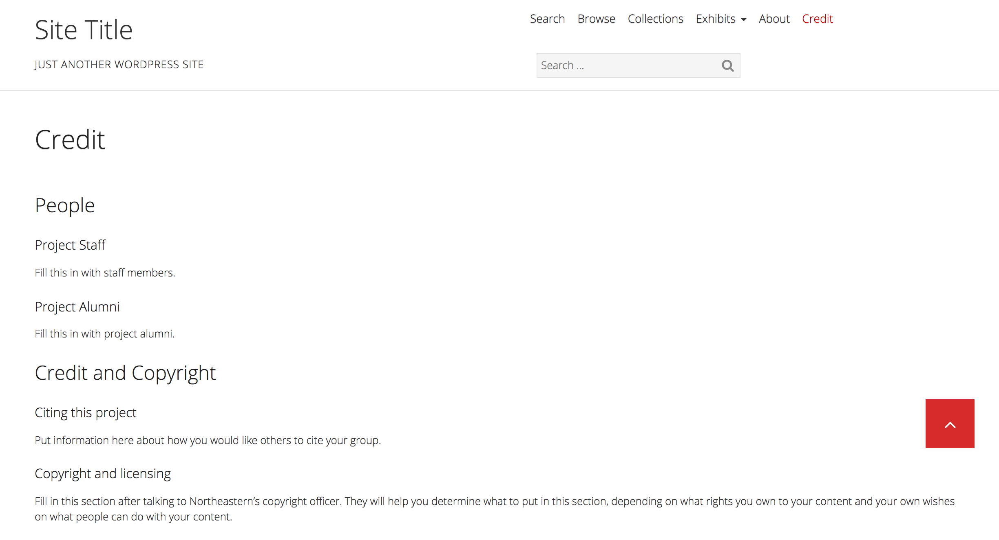
Framework

Slide 9
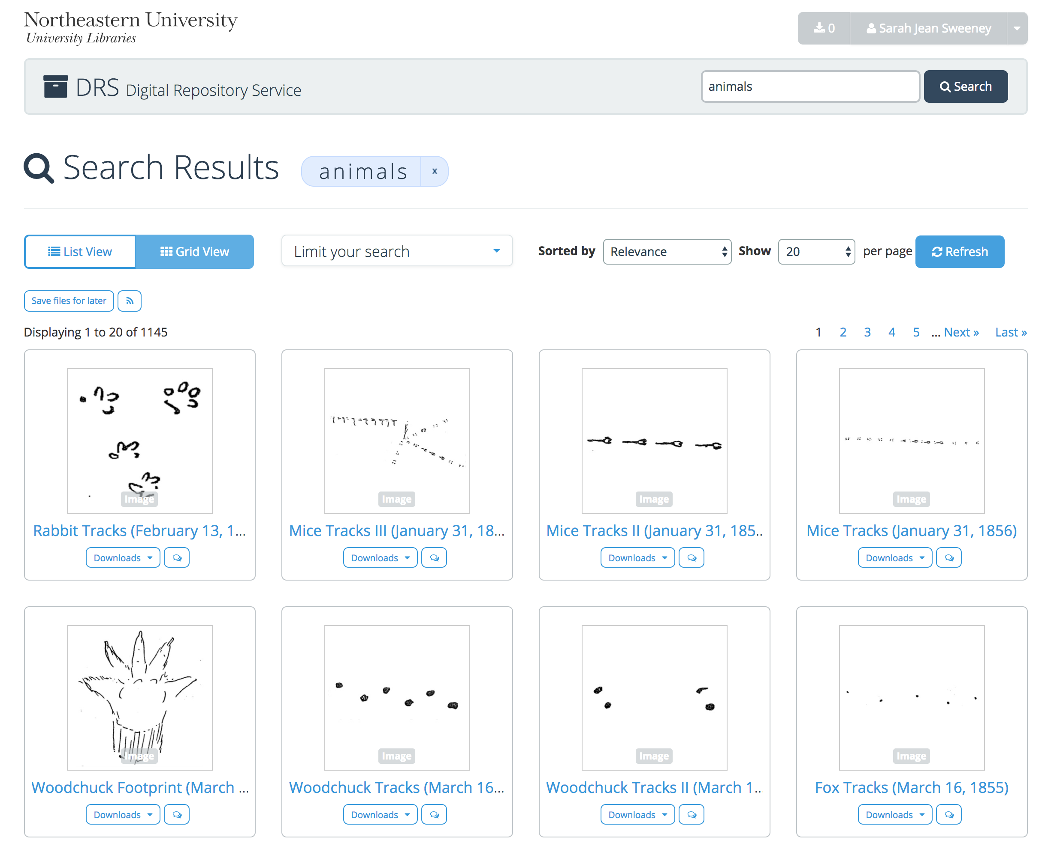
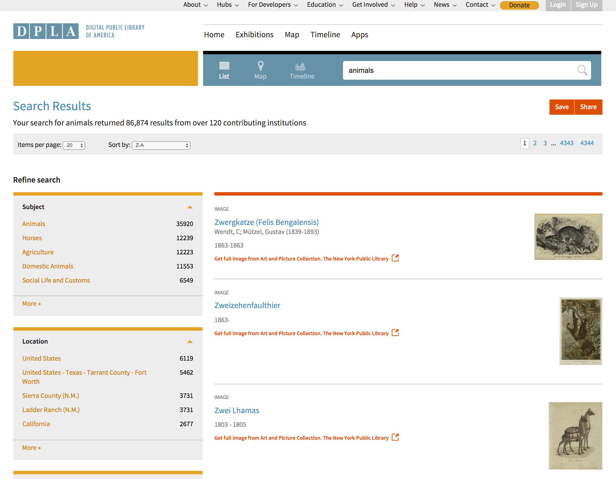
Data Sources
Digital Repository Service
(DRS)
Digital Public Library of America
(DPLA)

Slide 10
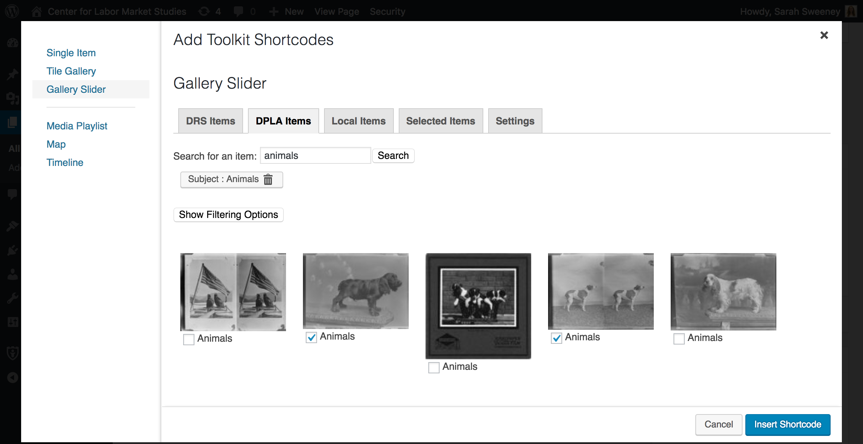
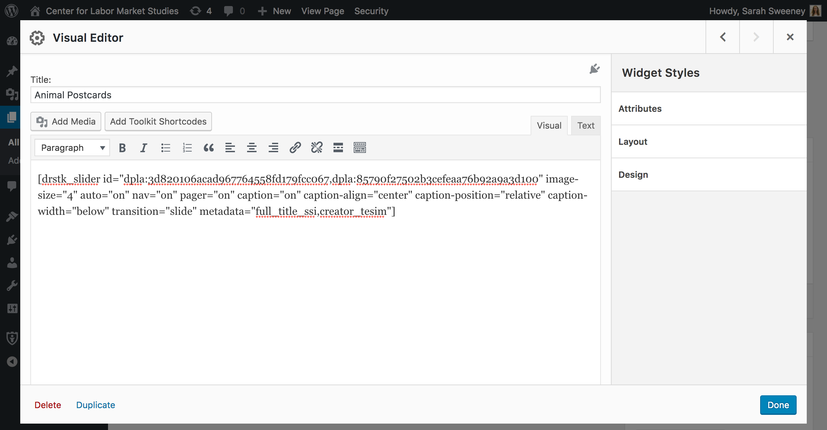
Exhibit Tools

Slide 11
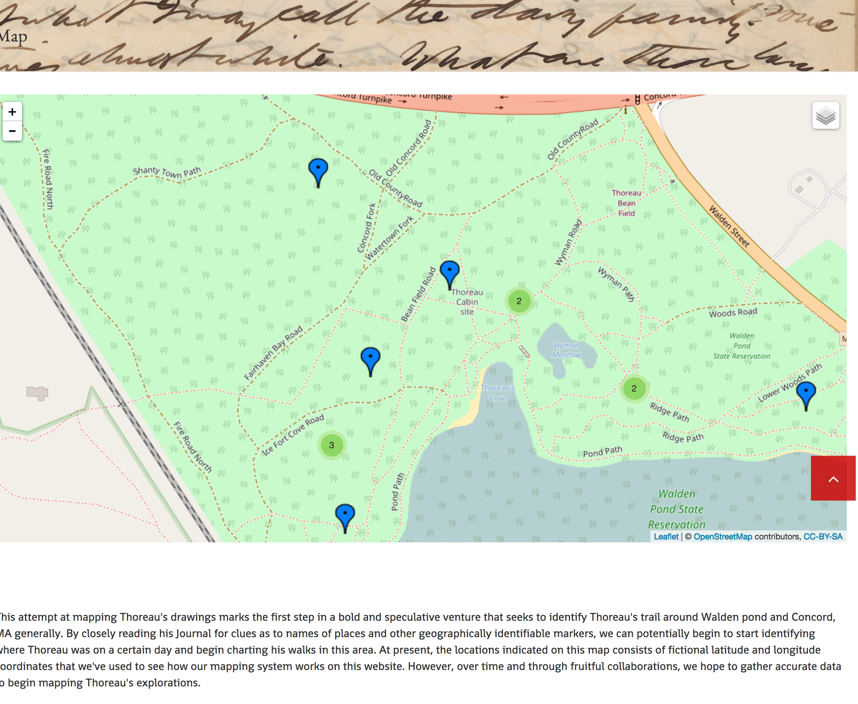
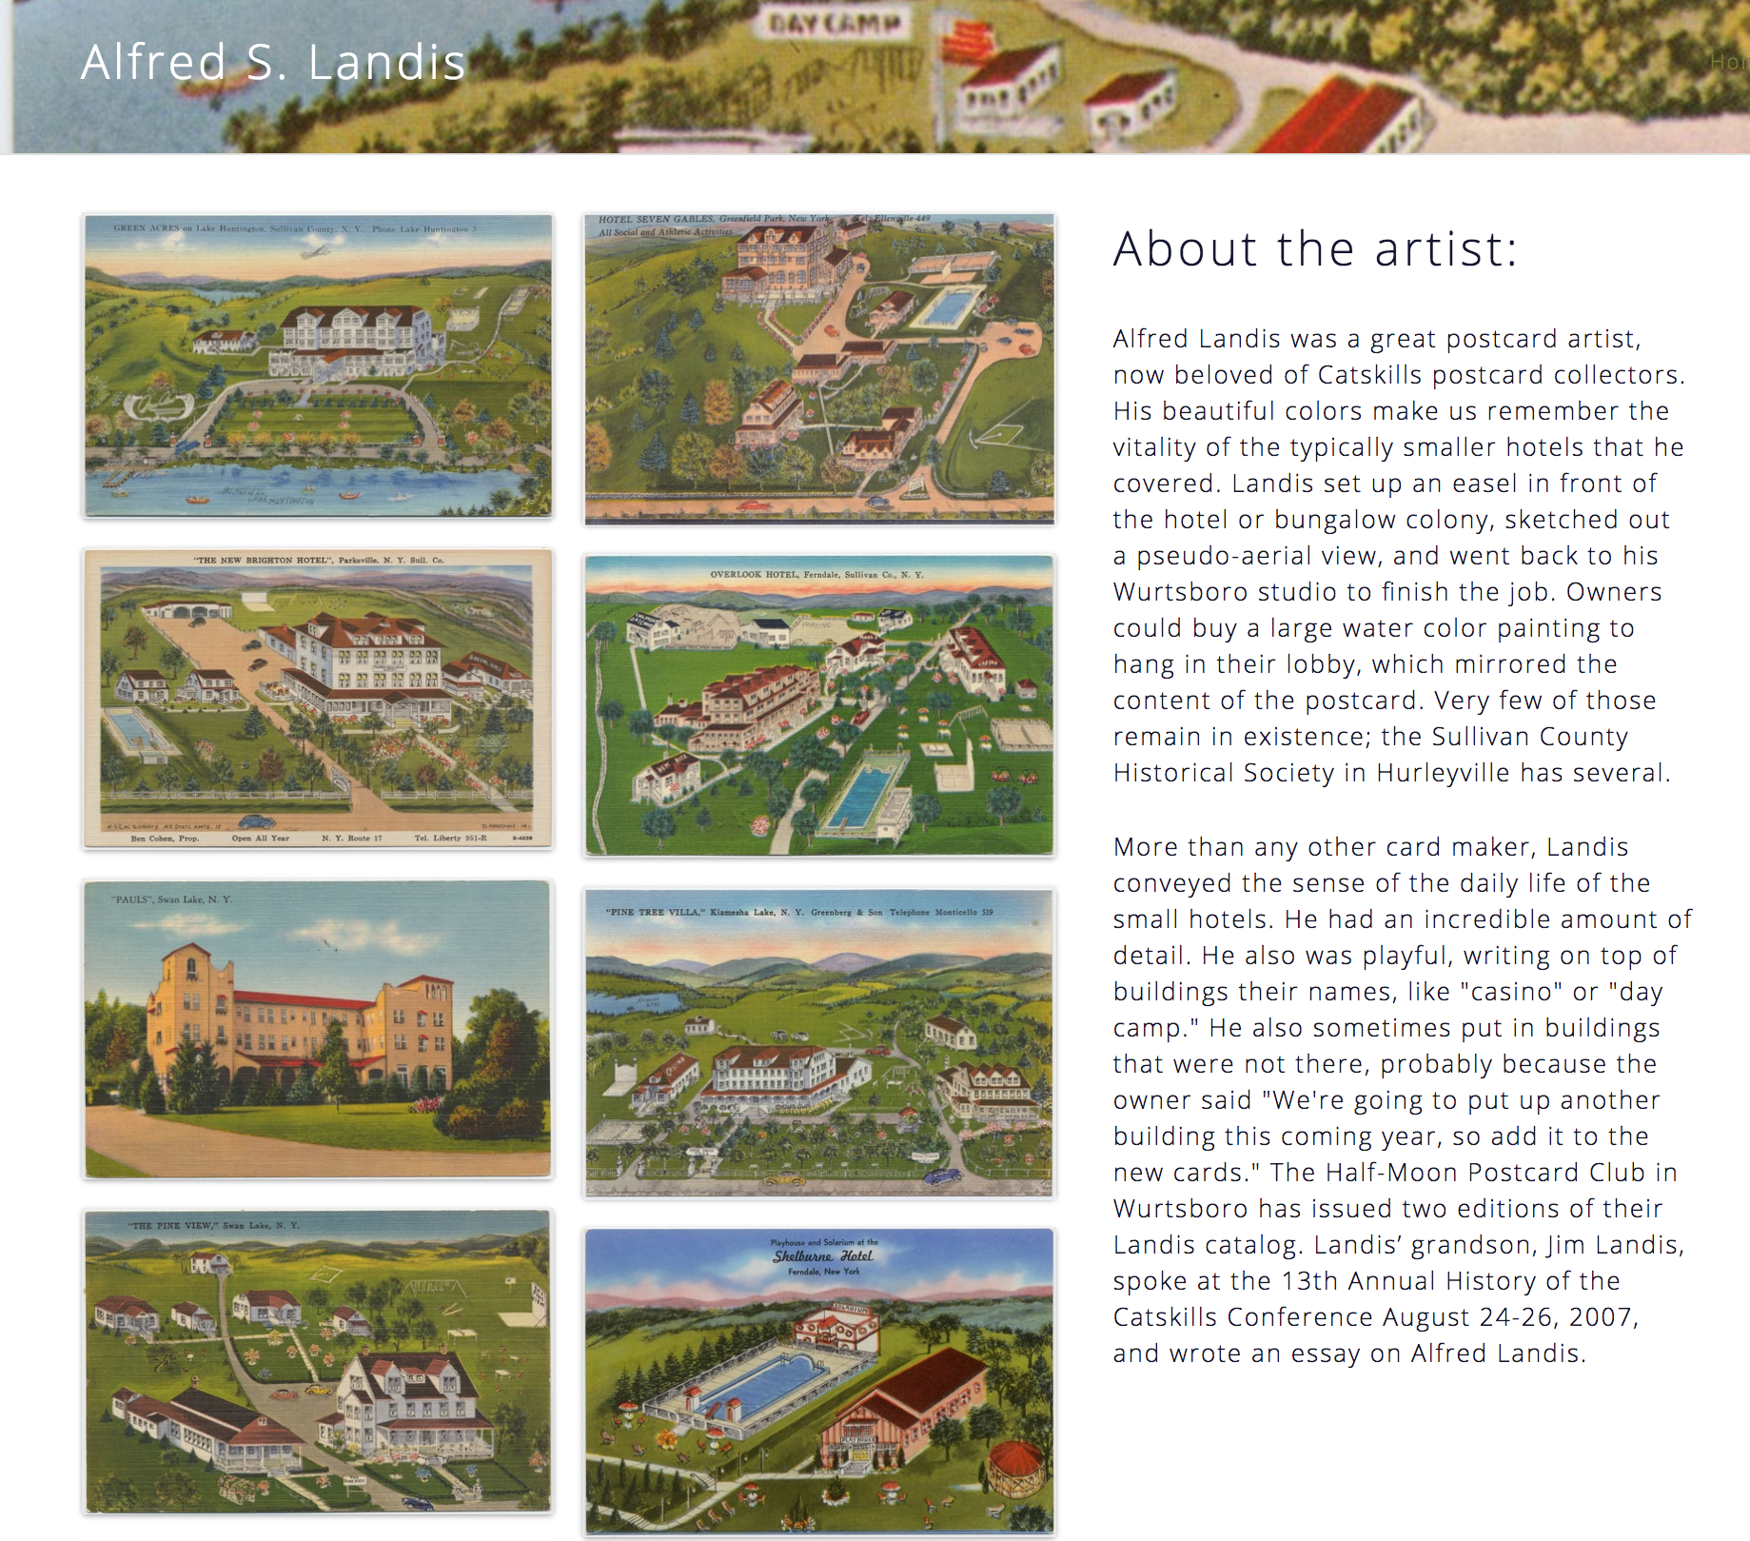
Exhibit Tools

Slide 12
Workflow
Annual Check-in
All DSG Projects Must:
Submit a project proposal
Participate in an intake interview
Write a data management plan
Participate in an annual check-in meeting.
Data Management Plan
Intake Interview
Project Proposal

Slide 13
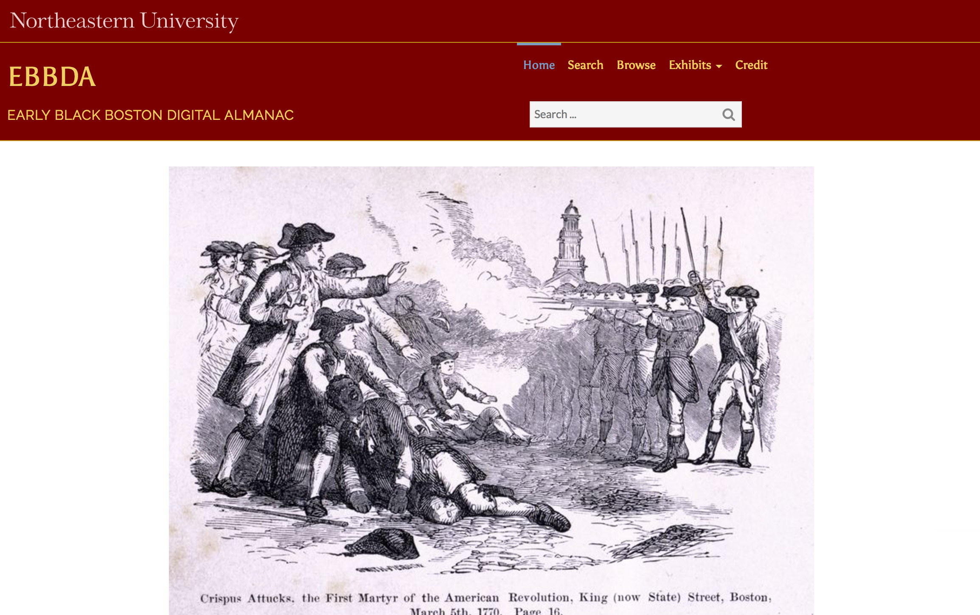
CERES Projects
Early Black Digital Almanac

Slide 14
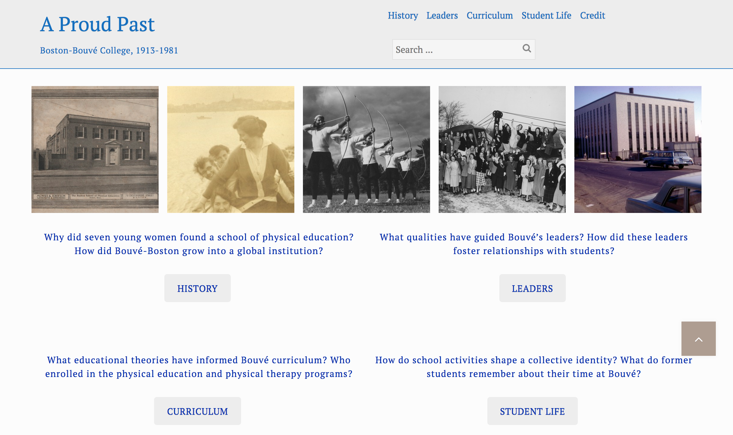
CERES Projects
A Proud Past: Boston-Bouvé College, 1913-1981

Slide 15
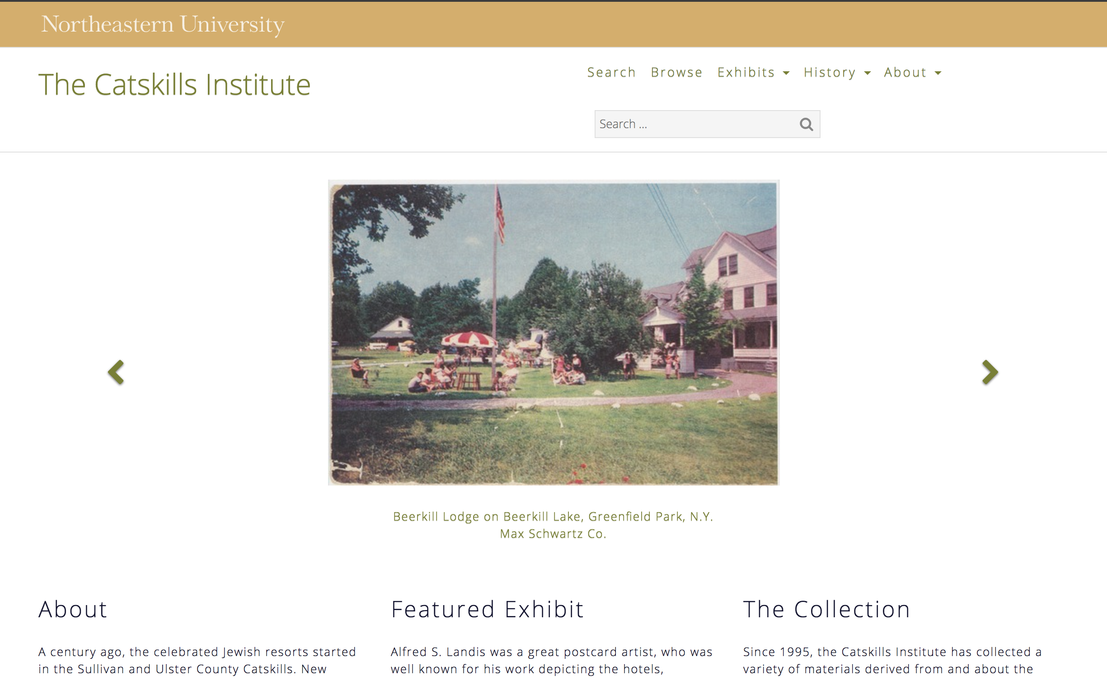
CERES Projects
A Proud Past: Boston-Bouvé College, 1913-1981

Slide 16
Outcomes

Slide 17
Next Steps

Slide 18
Questions?
Resources
Contact

